Slide 1
Project 1.3
Assessing deleteriousness of SNVs in Carl’s genome.
Yuyang Liu Zhaolong Yu Megan Brady

Slide 2
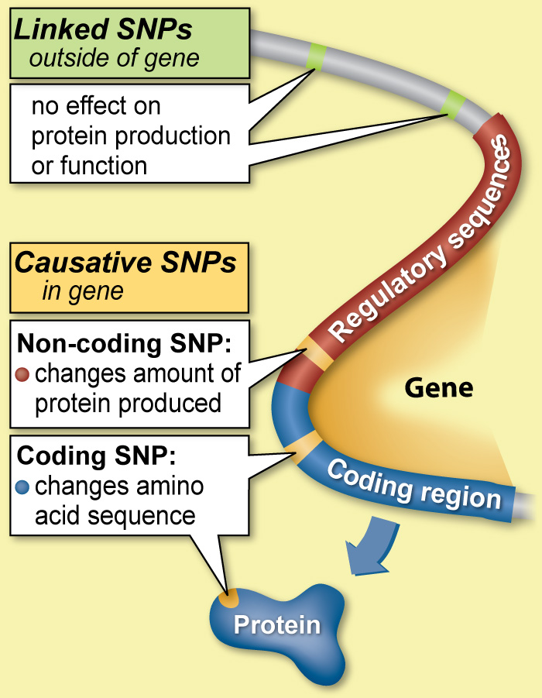
http://learn.genetics.utah.edu/content/precision/snips/

Slide 3
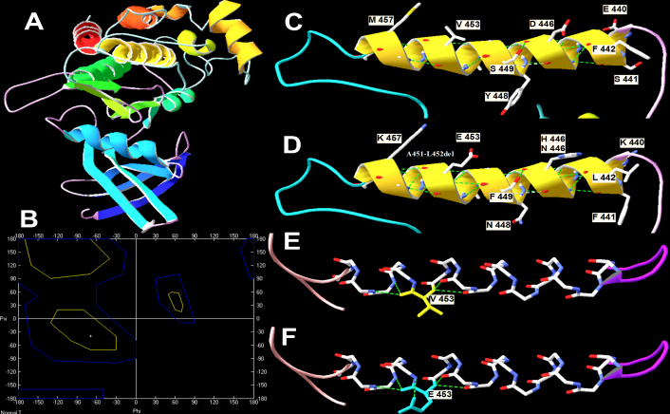
1. L. Zhang, L.-G. Gao, M. Zhang, X.-L. Zhou, Genotype-phenotype analysis of F-helix mutations at the kinase domain of TGFBR2, including a type 2 Marfan syndrome familial study. Molecular Vision 18, 55-63 (2012).

Slide 4
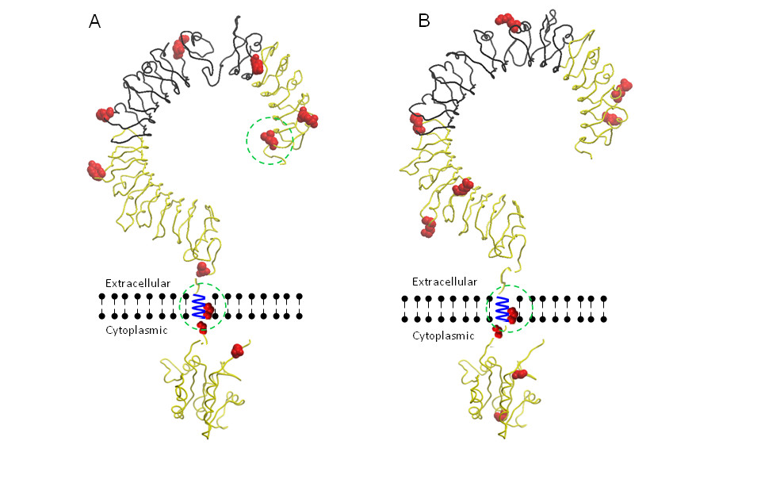
S. A. Smith et al., Adaptive evolution of Toll-like receptor 5 in domesticated mammals. BMC Evolutionary Biology 12, 122 (2012).

Slide 5
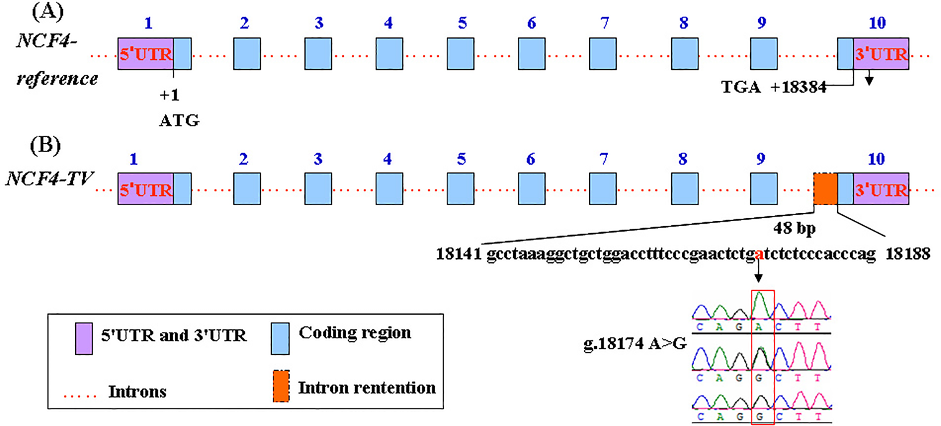
Z. Ju et al., Role of an SNP in Alternative Splicing of Bovine NCF4 and Mastitis Susceptibility. PLOS ONE 10, e0143705 (2015).

Slide 6
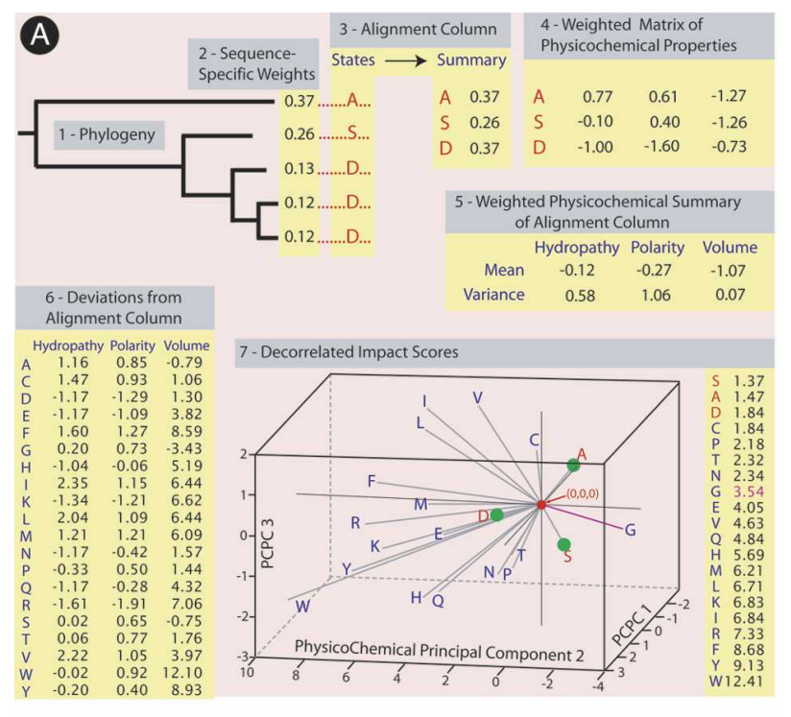

Slide 7
P. Kumar, S. Henikoff, P. C. Ng, Predicting the effects of coding non-synonymous variants on protein function using the SIFT algorithm. Nat. Protocols 4, 1073-1081 (2009).

Slide 8
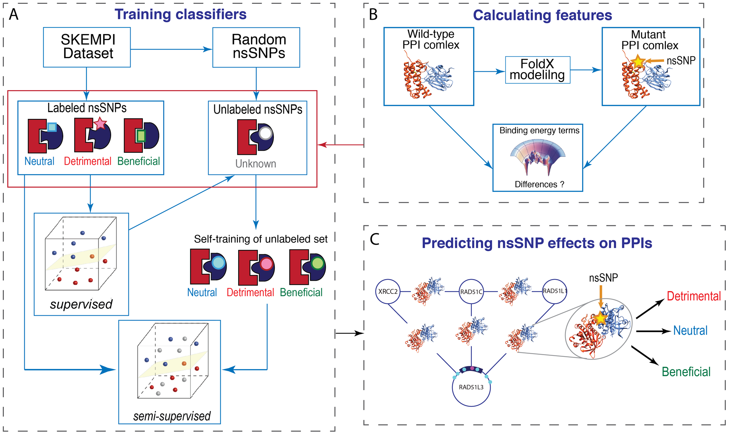
N. Zhao, J. G. Han, C.-R. Shyu, D. Korkin, Determining Effects of Non-synonymous SNPs on Protein-Protein Interactions using Supervised and Semi-supervised Learning. PLOS Computational Biology 10, e1003592 (2014).

Slide 9
Programs to Classify SNPs
Polyphen2
PROVEAN
SIFT

Slide 10
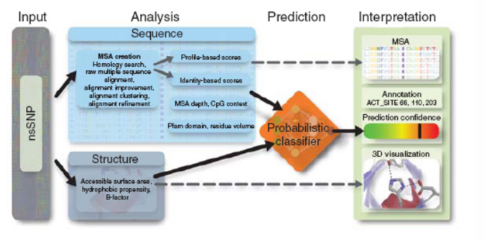
PolyPhen2
Adzhubei et al. 2010

Slide 11
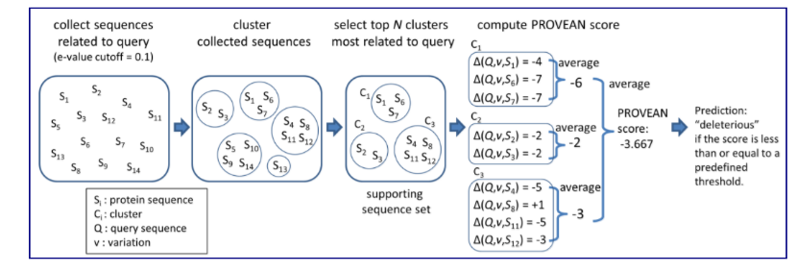
PROVEAN
http://provean.jcvi.org/about.php

Slide 12
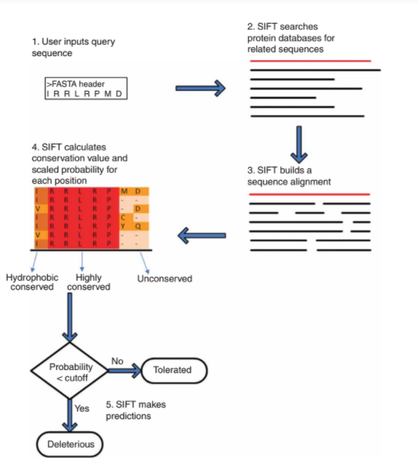
SIFT
Kumar et al. 2009

Slide 13
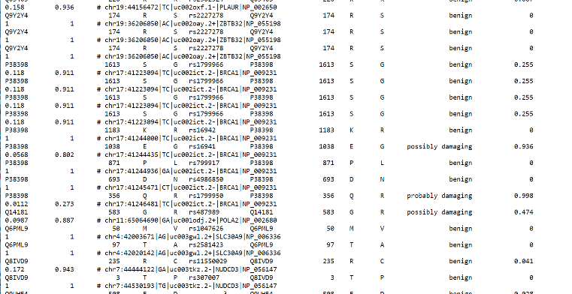
Polyphen2
Probability calculated through Bayes classifier
Benign (0-.45), possibly damaging (.45-.95), probably damaging (.95-1)
Adzhubei et al. 2015

Slide 14
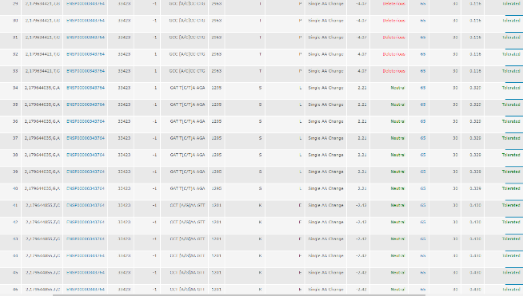
PROVEAN & SIFT

Slide 15
Analyzing the Zimmer Genome
Brown = Present in dbSNP
Blue = Unique

Slide 16
Comparison of Various Programs
 | PolyPhen2 | PROVEAN | SIFT
Benign | 2669 | 3104 | 2851
Possibly Damaging | 293 | 0 | 0
Damaging | 344 | 420 | 658
Undetermined | 0 | 6 | 21
 | PolyPhen2 | PROVEAN | SIFT
Single Amino Acid Change | 3281 | 3514 | 3514
Synonymous | 15 | 10 | 10
Nonsense | 10 | 6 | 6

Slide 17
Comparison of Various Programs
Brown = Neutral
Yellow = Damaging
Blue = Possibly damaging
Gray = Undetermined

Slide 18
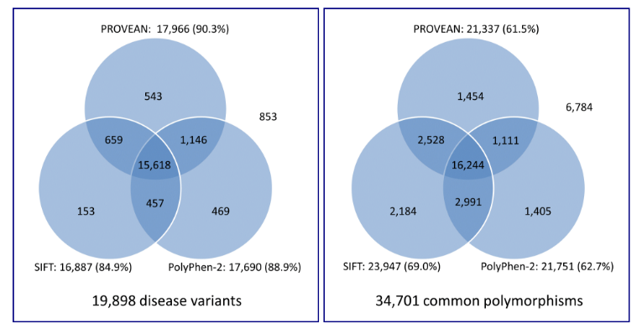
Comparison of Various Programs
http://provean.jcvi.org/about.php

